Slide 1
Family Planning Estimation Tool (FPET)
Using Modeling to Estimate Annual Values of Modern Contraceptive Prevalence and Other FP Indicators

Slide 2
Objectives
Why monitor FP indicators annually?
Why use modeling to estimate mCPR?
What is FPET and what are its origins?
What are the advantages to using FPET?
      Case studies
Notes:
This presentation will introduce you to the basics of the Family Planning Estimating Tool, or FPET. FPET is a model designed to use all available data to develop annual estimates of three indicators commonly used to track progress in a family planning program beyond the date of the last survey and into the future.
But before we delve into the details of the model, we are going to learn more about why developing annual estimates of FP indicators is important, why we use modeling to accomplish this, and the origins of FPET. This background will help you understand the gap FPET is filling and how FPET results can help monitor programming and track progress.
Then we’ll get more into the specifics of FPET and its advantages and share some case studies of how countries have used results.

Slide 3
Why annual estimates?
Notes:
First, let’s talk about why annual estimates are important.

Slide 4
Why do we need annual estimates?
Because countries normally have 5-year strategies, waiting 5 or more years between national surveys for data limits a country’s ability to monitor progress.
Without annual data how do we answer the questions:
What proportion of women are using modern contraceptives?
Are our family planning programs having the impact we expect/want?
Are we making progress?
We need annual estimates for key family planning indicators to answer these questions and understand how we are progressing.
Notes:
Nationally representative household population surveys like the Demographic and Health Survey, or DHS, are most often the source of data that informs national strategies and budgets in a country. While these surveys are a gold-standard for data on health issues, completing one is complex and takes significant time and resources. There are often gaps of 5 or more years between the release of data from these surveys. Having reliable data only every five or more years is a problem because most strategies have 5-year implementation periods. This means that often there is no new data available during implementation to let countries know if programs are having their intended impact, and if programmatic adjustments need to be made.
By having annual estimates of key family planning indicators, countries are better able to monitor progress, estimate how mCPR and unmet need are changing in response to current programming and make necessary adjustments to accelerate progress toward their FP goals.

Slide 5
How can we best estimate current mCPR?
Use the most recent survey?
Extrapolate the trend from the last two surveys?
Extrapolate the trend from the last three surveys?
Extrapolate the trend from all available surveys?
Service statistics can provide annual estimates but are they accurate?
?
Notes:
We now understand that having annual estimates is helpful. One of the main indicators we use to track progress is the modern contraceptive prevalence rate (mCPR). So what are some way that we can develop estimates of a country’s mCPR?
I’ve listed here several ways that mCPR estimates could be generated to help us see what progress has been made since out last data point. The problem is that each of these approaches may lead to a different outcome.

Slide 6
Different surveys may give very different results
Previously we may have attempted to estimate current mCPR and project future trends based solely on past survey trends which may give radically different results.
Notes:
Even among surveys, which are the most trusted data source, results vary due to difference in survey design and sampling and implementation.

Slide 7
Using Modeling to Estimate Annual mCPR
Already done in:
  HIV field
  Maternal Mortality Ratio
  Child survival programs
Similar methodologies are appropriate in FP
  Have the advantage of lessons learned from these other fields
Notes:
Rather than try to use these approaches that force us to choose 1 data point over others, or result in varied estimates, we have found that predictive modeling methods help us make the best estimates.
Other health fields like HIV and maternal and child health have used modeling to generate estimate successfully for years and there is no reason that family planning should not also use modelling to help estimate current and future data points to facilitate better planning and monitoring.

Slide 8
Track20’s Family Planning Estimation Tool (FPET)
Notes:
Now that you know more about modeling in general, let’s get into FPET specifically.

Slide 9
An Existing Model Provides the Framework for FPET
  UN Population Division (UNPD) has an estimation model that already produces annual estimates of key family planning indicators:
      CPR
      mCPR
      Traditional Method Use
      Unmet Need for Modern Contraception
      Demand Satisfied by Modern Contraception
Sources:
Alkema L, Kantorova V, Menozzi C, Biddlecom A. “National, regional, and global rates and trends in contraceptive prevalence and unmet need for family planning between 1990 and 2015: a systematic and comprehensive analysis”. Lancet 2013; published online March 12. http://dx.doi.org/10.1016/S0140-6736(12)62204-1.
Notes:
Let’s start by learning more about how models work and the origins of FPET.
The United Nations Population Division (UNPD) has an existing model that provides key annual estimates for family planning indicators such as CPR, mCPR, traditional method use, and unmet need and demand satisfied for modern contraception. Track20 built on this existing framework to develop FPET.
Both the UNPD model and FPET allow you to measure annual progress on key family planning indicators, however there are also a few key differences between the UNPD and Track20 model and I will discuss those next.

Slide 10
Track20 Built on UNPD Framework to create the Family Planning Estimate Tool (FPET)
Modifications to the UNPD Model
One Country Version
  Ability to run one country at a time
    (UNPD model runs all countries and takes multiples days)
  Prior assumptions on some parameters are informed by regional and sub-regional values from global model
Potential to Add Service Statistics to Inform Estimates
  Informs projection past the last survey point
  Estimates are “anchored” by surveys
  Allows for estimates to be modified based on annual data, so we can see if we are continuing on the same trajectory, or shifting the line up or down
Available Online for Open Use
Notes:
There were some key modifications made to the UNDP model to make it more flexible for use by individual countries.
Modification 1: One country version
First, the Track20 model is a one country version of the UNPD’s global model. What does that mean? Well, when the UN runs its model, it takes multiple days and it runs the model for the entire world.
Our model allows you to run one country at a time and is much faster – it takes about 15 minutes per country. It does not contain data for every country in the world - data is pre-loaded for the 69 poorest countries.
The model works in a similar way as the UNPD model and some parameters (meaning inputs into the models) it uses are informed by regional and sub-regional values from the global model.
Modification 2: Potential to Add Service Statistics
Our model also allows you to add service statistics (we will talk more about the value of adding service statistics in a later session)
You may not have current survey data, but you do have regularly collected, country owned data that can show the trends of your indicators – the absolute value may not be the same as survey data, but we can see the direction of change.
This more current data helps you inform the projection past the last survey point.
The estimates are anchored by surveys meaning that the service statistics helps inform the family planning indicators by “trend” rather than the “absolute” increase/decrease
Having service statistics often does reduce the confidence interval around estimates.
Modification 3: Available Online for Open Use
The model is available free of use for everyone to use.

Slide 11
Track20 Built on UNPD Framework to create the Family Planning Estimate Tool (FPET)
Key Differences
1. Databases
  UN database is larger
  Closes their database earlier than Track20
2. Country dynamics
  UN treats all countries the same – if there is available data they will include it, unless specifically asked by the country not to.
  Track20 works with countries individually and is able to jointly make decisions to include additional data or exclude some data.
3. Lactational Amenorrhea Method (LAM) is recorded differently in select countries
Notes:
In addition to the modification of the structure and availability of the model, there are other key differences between the Track20 and UNDP model.
Difference 1: Database differences
We are looking at different databases – the UN’s database is much larger – it includes all countries. The Track20 database only includes the 69 poorest countries.
UNPD closes their database months before the Track20 database closes…so a survey that comes out after the UNPD data base is closed for the year may still show up in the Track20 database for the year
Difference 2: Country dynamics
The UN treats all countries the same – they will use all data available to them unless they get a letter from the govt requesting not to include certain data.
Track20 has more interaction with individua countries and can collaborate with local technical experts to take country data context into consideration
Difference 3: LAM is recorded differently
Lactational amenorrhea method (LAM) is recorded differently in Track20’s methodology than in the UNPD’s. This difference only impacts a few countries: Central African Republic, Cameroon, Congo, Somalia

Slide 12
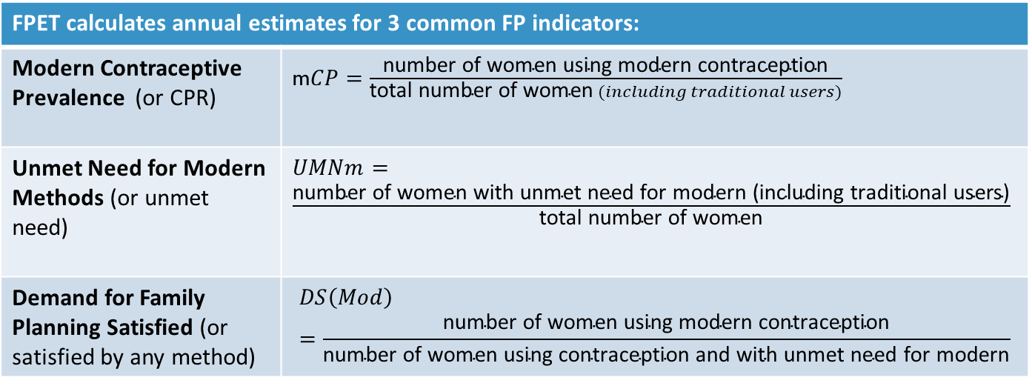
What is FPET?
FPET is designed to use all available data to develop annual estimates of three indicators commonly used to track progress in a family planning program beyond the date of the last survey and into the future.
FPET calculates annual estimates for 3 common FP indicators:
Modern Contraceptive Prevalence (or CPR) | m$CP=\frac{\text{number} \text{of} \text{women} \text{using} \text{modern} \text{contraception}}{\text{total} \text{number} \text{of} \text{women} (including traditional users)}$
Unmet Need for Modern Methods (or unmet need) | $UMNm=\frac{\text{number} \text{of} \text{women} \text{with} \text{unmet} \text{need} \text{for} \text{modern}\text{ (}\text{including} \text{traditional} \text{users}\text{)}}{\text{total} \text{number} \text{of} \text{women}}$
Demand for Family Planning Satisfied (or satisfied by any method) | $$DS\left(Mod\right)=\frac{\text{number} \text{of} \text{women} \text{using} \text{modern} \text{contraception}}{\text{number} \text{of} \text{women} \text{using} \text{contraception} \text{and} \text{with} \text{unmet} \text{need} \text{for} \text{modern}}$$
Notes:
Now that we know the model that FPET was based on, let’s get into detail on FPET.
FPET is designed to use all available data (all surveys and service statistics where appropriate) to develop annual estimates of three indicators commonly used to track progress in a family planning program beyond the date of the last survey and into the future. The three indicators are detailed on this slide.

Slide 13
Model Methodology
The UNPD Model & Track20’s FPET are both
“Bayesian hierarchical models”
A Bayesian hierarchical model is a statistical model that estimates the likelihood of a given result based on prior observed values and is informed by data at multiple levels.
For the purpose of producing annual estimates of contraceptive prevalence, these models incorporate:
multiple sources of data (surveys: National, DHS, MICS, PMA, Service Statistics)
data points over time (survey results and trends: CPR, mCPR, Unmet Need)
different levels of data (country/regional/global)
Using this information, the model aims to provide the best estimate of each indicator given all available data and an estimate of the confidence interval around each data point.
Notes:
FPET is a Bayesian hierarchical model, meaning that it estimates the likelihood of a given future result based on global knowledge of how countries’ contraceptive prevalence rates have historically transitioned from low to high, and is informed by data at multiple levels (country, sub-regional, regional, global). FPET is unique in that it considers survey data, service statistics (where determined to be of adequate quality), and regional and global historical patterns of change to produce annual estimates of mCPR and unmet need. For FPET, more data points, even conflicting ones, only strengthen the model’s ability to predict future trends.
Because FPET is a Bayesian hierarchical model- if a country has little data, the regional and global trends plus historical time trends will provide the best estimate for the current year.

Slide 14
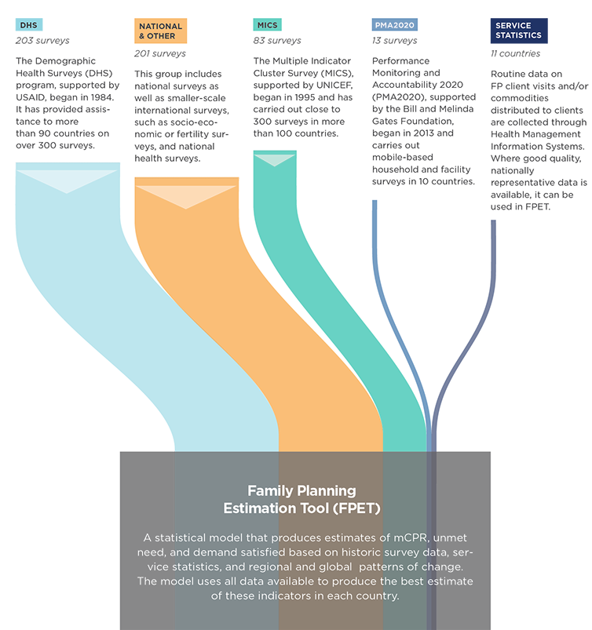
Incorporating Multiple Data Sources and Levels
FPET uses data from a wide range of sources to inform annual estimates of key family planning indicators.
Sources include:
DHS
National and International Surveys
MICS
PMA2020
Service Statistics
Notes:
This graphic shows you the data that is incorporated into FPET. Since most of the surveys are DHS and national surveys – they make up the largest part of the Track20 database.
And remember that a Bayesian hierarchical model pulls from the most relevant data available as follows:
Data hierarchy: (decided by standard errors – DHS, MICS, National, PMA2020, service statistics)
Regional hierarchy: (World level, Major region (e.g., Africa), Sub-region (e.g., Eastern Africa), Country (e.g., Kenya))
Temporal hierarchy: Time trends closer in time have a larger influence in the model as well.

Slide 15
Incorporating the Family Planning S-Curve
mCPR typically grows in a S-Shaped pattern, with growth starting out slow at low levels of mCPR, accelerating with rapid growth for a period and then levelling off as mCPR reaches a maximum level.
This pattern is incorporated into the model, determining the potential rate of growth in mCPR based on previous national, regional and global trends as well as the level of mCPR.
Notes:
This graphic shows you that FPET incorporates the family planning S-curve. What is the S-curve? The S-curve is based on off historical trends of mCPR growth. This type of growth is known as logistics growth. A logistic growth curve models the trend from low to high CPR, estimating where growth begins, how steep the curve is at midpoint, where/when the midpoint occurs and where growth levels off, based on all available data. We call it a S-curve because it is not completely linear or in a straight line, but historically growth happens in some variation of curve that resembles the letter “S”.
As you see in stage 1, there is little or slow growth, in stage 2, there is a period where the length spent in this period and speed of growth vary, but in general there is greater potential for rapid acceleration, and in stage 3 growth starts to slow because you’ve reach a country’s likely maximum mCPR. Remember, no country will ever have 100% of women of reproductive age using a family planning method – at some point you will saturate the market of women who want to use family planning.
Why is it important for FPET to incorporate the S curve into it’s methodology?
So the model produces estimates for countries that follow this general trend – we know based on observed survey data that this is the way mCPR grows historically. FPET uses all the data I just spoke about as well as this concept of logistic growth to make the best estimate.
Remember that even though historically countries fit the S curve, not all countries will move through the 3 stages at the same rate. Some countries will have a very steep Stage 2 and some will have a longer, flatter stage 2. There are many environmental, social and political factors that can affect a country’s trend.

Slide 16
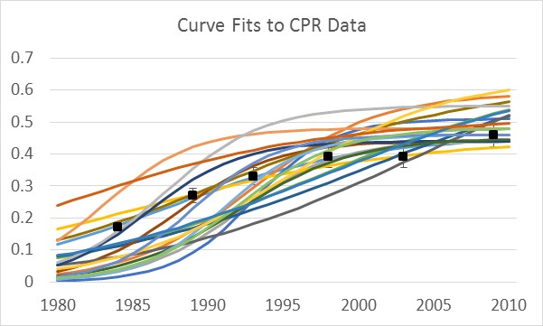
Fitting a Curve to Survey Data
The model creates thousands of potential curves, searching for the curve/trend that best fits the data provided for a given country. This curve is used to estimate the current value for Contraceptive Prevalence and develop projections for future years.
Notes:
How does FPET use the S-curve in its modeling?
In FPET, and in Bayesian modeling in general, the model creates thousands of curves (as depicted here) searching for the best fit. Once the model has finished running and the best fit has been identified, the results you see in FPET are from that best fit.

Slide 17
Communicating the Value of FPET in 4 Case Studies
Notes:
The best way to understand how FPET estimates can be used is to walk through some country examples that highlight circumstances when having annual estimates is especially useful for planning and monitoring.

Slide 18
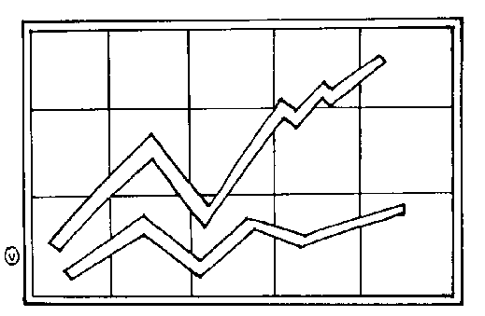
FPET is useful when you have:
A lot of survey data (varying types of surveys)
Conflicting survey information
Little data
Outdated data
Notes:
I will walk you through 4 examples that help explain the value of using FPET and modeled estimates. These example will show how FPET can be particularly useful when you have:
Conflicting information – when the data you have does not all follow a similar trend and does not have the same level of trend
Varying surveys in given years – when you have different types of surveys such as MICS or DHS– they might have differing values but similar overall trends
Little data – when there are not a lot of historical data points to help you estimate what the future will look like
Outdated data – when the data you have is so out of date that there is a good chance that estimates based on the old data will not reflect current reality

Slide 19
1. When you have a lot of data survey (of varying types)
Nigeria
Nigeria has many different surveys
Different levels can make interpretation difficult when looking at them individually
When combined, all are telling the same narrative of minimal growth – see a common trend
Notes:
NOTE: This slide includes animation. Click once more to make the FPET estimate trend appear on the graph.
Let’s start with scenario 1 – when you have a lot of survey data to interpret.
Nigeria has many different kinds of surveys implemented in-country. We see that the surveys produce different results and that even surveys with results in the same year may show varying levels. Different levels can make interpretation difficult when looking at them individually.
[Click for animation]
When combined in the FPET estimate (shown by the dotted green line), we see that though the absolute values are different, the trends are telling the same narrative of minimal growth. Transforming all available data into 1 trend makes it easier to judge progress.

Slide 20
2. When you have lots of conflicting information
Ghana
2000-2015:
10 Surveys
4 Different types of survey (DHS, MICS, PMA, & National)
Shifting survey values can cause confusion and make it difficult to develop a narrative around change in Ghana.
There can also be politics associated with using one survey over another when discussing the current situation
Notes:
In scenario 2 we have a lot of data that is conflicting.
In Ghana there are also a variety of survey results available, but they are telling different stories about progress and the trends are not consistent.
If you choose 1 data point to trust, will it be telling the whole story? Sometimes selecting 1 type of data above others can be politically tricky as well.
Finally, all surveys include some uncertainty (expressed as confidence intervals around data points), so only looking at the single data point can be misleading.

Slide 21
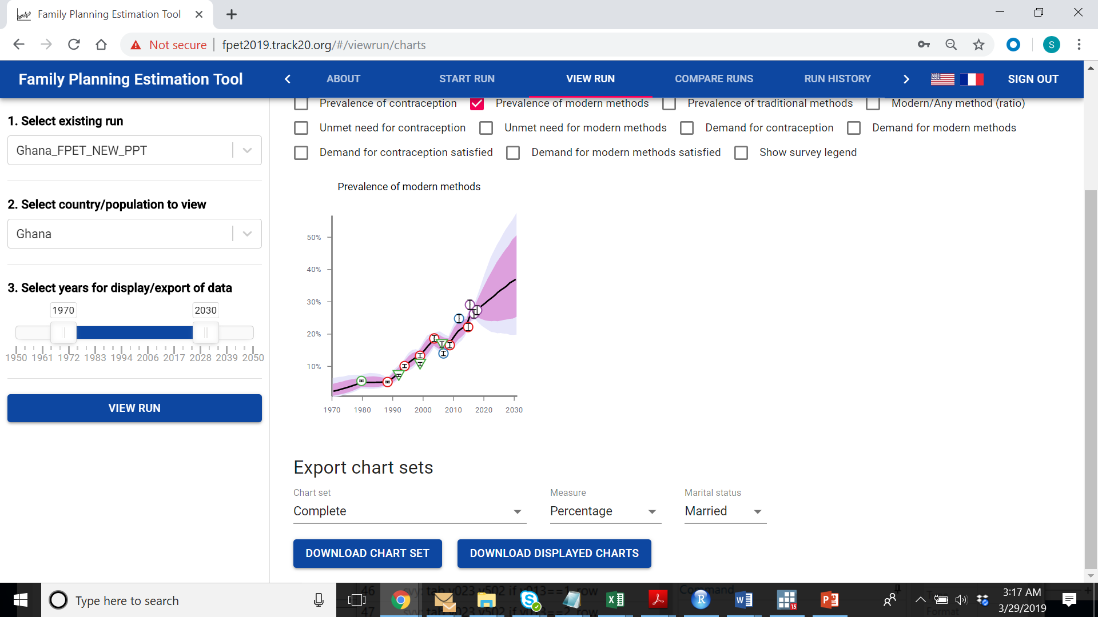
Ghana: conflicting information
FPET takes into account all of the data available for Ghana, as well as regional and global trends in growth in mCPR to create one estimate trend, incorporating the uncertainty around the estimate and variability between surveys.
In this case, FPET can help create a single narrative of progress and avoid the challenges of choosing one data point or debating the merits of the available data/studies. More data is better and FPET uses it all to inform estimates.
Notes:
Because FPET incorporates all available data into the estimate, you do not have favor 1 type of data over another. Finding a trend that considers all the data also helps to smooth the line out to show the trend without being distracted by the absolute values.

Slide 22
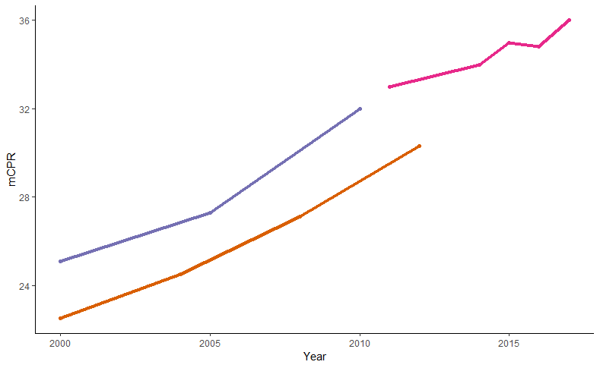
Conflicting information: differing surveys between years
PMA2020
DHS
MICS
FPET
Notes:
NOTE: There is animation to this slide – click 1 time to highlight data differences and a 2nd time to show FPET trend line.
This slide is expanding on the idea of conflicting information we just discussed. If you look at this graph, what would you notice? Looking across all of the information we see that overall mCPR is increasing in this country, but the green dashed line shows how much the trend jumps around across surveys. This can lead to false adjustments made in reaction to data changes.
[click for animation]
For example – if it’s 2007, and your DHS just came out, you would be disappointed and would think that your mCPR declined from 2005. You would question the validity of your FP programs and services. Another discrepancy is seen between the 2015 PMA2020 and 2016 DHS results. What is happening? You are comparing different survey types and the actual mCPR and not the trend.
[click for animation]
This issue can be rectified by FPET. FPET with will take all the available data and recognize that even though the survey estimates are not the same the general survey trend is positive and similar. A potential FPET curve would then look like the blue line.
If you have a survey in the current year, you might ask, why don’t you just use the estimates from the survey? Because it is better to use estimates that combine all existing data and follow historical trends and not just absolute values between surveys. Modeled estimates are different from surveys and service statistics because they incorporate a variety of data. This allows countries to not be artificially punished or rewarded for what appear to be sudden increases or decreases in mCPR, possibly leading to unnecessary adjustments to the program. With FPET the trend is made clear so general progress can be assessed.

Slide 23
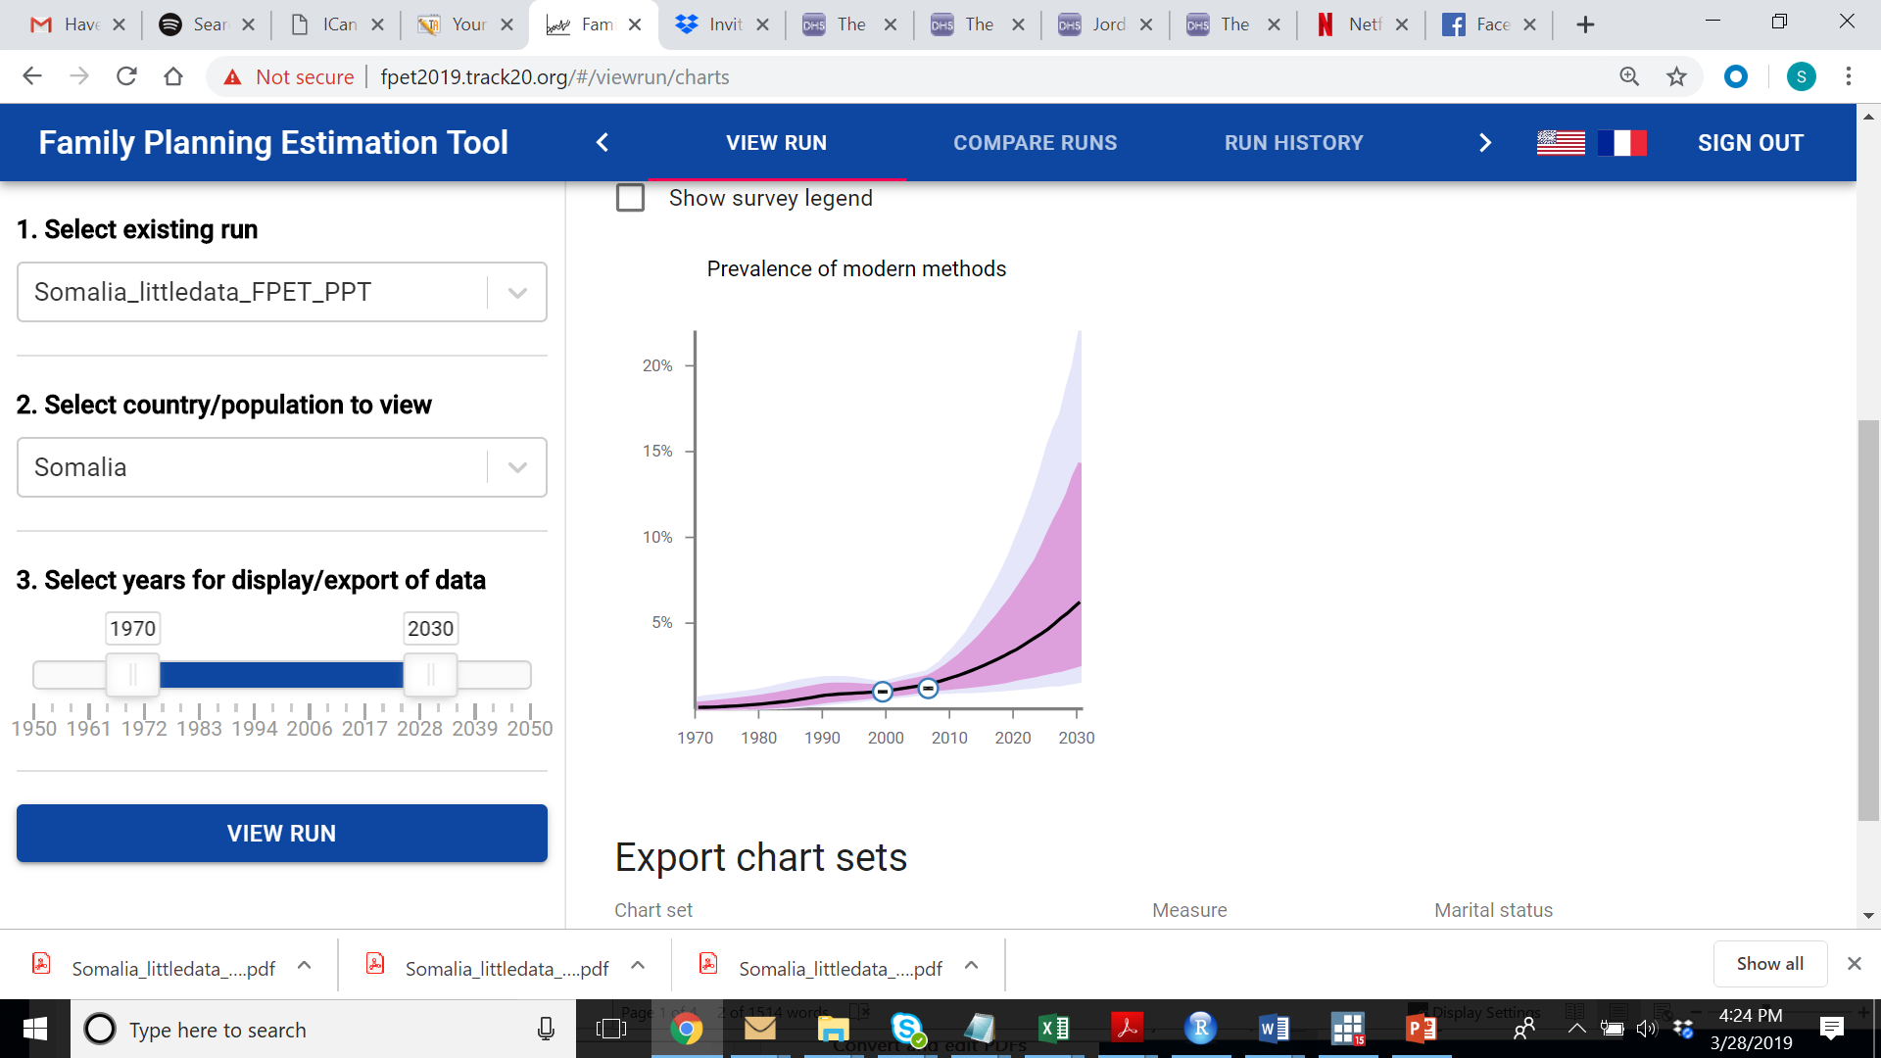
3. When there is very little data
Somalia
1970-2019:
Only 2 MICS (1999 & 2006)
Difficult to discuss progress or changes when there is so little data, but we know (based on regional and global trends) that prevalence is not likely to be stagnant
FPET uses hierarchical data to inform the trend in mCPR, providing a growth narrative (with caveats – note the confidence interval), rather than an unchanged estimate from 13 years ago.
Survey (2006) mCPR (MW) | FPET (2019) mCPR (MW)
1.2% | 3.7%
With FPET estimate, we see conservative estimate of .19% pt growth per year.
Notes:
Scenarios 3 – when there is very little data, as was seen in Somalia where they last had surveys in 1999 and 2006.
It is difficult to assess progress or changes when there is so little data, but we can make an educated guess (based on regional and global trends) that prevalence is not likely to have remained stagnant since 2006.
FPET uses hierarchical data to inform the trend in mCPR, providing a growth narrative rather than an unchanged estimate from 13 years ago. When no country data is available, it looks to regional and global trends to inform estimates. Because the estimate is based on older and non-country-specific data, you may note that the confidence intervals around the trend estimate are larger.

Slide 24
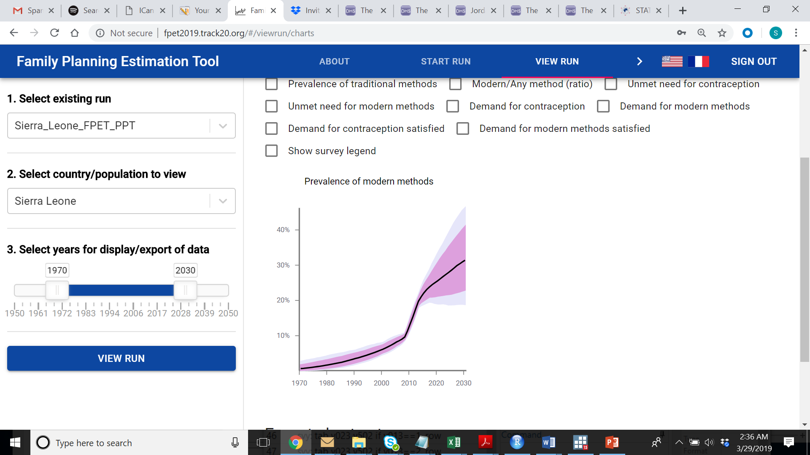
4. When our data is outdated
Sierra Leone
Last Survey: 2013 DHS
FPET allows us to estimate progress (based on existing data as well as what we know about mCPR growth – S Curve) rather than rely on outdated survey
When 2017 MICS results came out, FPET results were largely validated.
FPET can now be updated with the new data to produce even better estimates going forward.
Survey (2013) mCPR (AW) | FPET (2017) mCPR (AW) | MICS (2017) mCPR (AW)
22.1% | 25.9% | 25.5%
FPET estimated .95% pt growth per year.
Survey indicated .85% pt growth per year
Notes:
Scenario 4 is outdated data. In Sierra Leone the last survey was in 2013 and regional trends would suggest that the mCPR would have been growing since then. When Sierra Leone went to develop a new strategy in 2017, they ran an FPET, which pulled from the outdated data, but was also able to incorporate the regional and global trends to inform the estimate – which showed a significant increase.
A new MICS survey that also became available in 2017 validated with current data FPET’s optimistic estimate.
Now that FPET has another country-specific data point to incorporate, the estimate will be even closer next time.

Slide 25
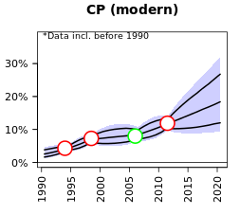
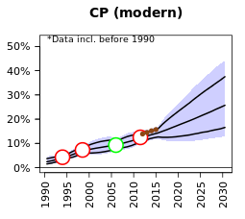
Service statistics can improve our estimates
Cote D’Ivoire
1980-2015:
5 Surveys
Last Survey as in 2011 (Before FP2020) , but we know that with FP2020 and OP, it is likely that prevalence is growing
Cote d’Ivoire has consistent trends in service statistics (clients), overlapping with the last survey, that indicate a steady upward trend.
Incorporating service statistics:
  provides more data on recent trends (especially important in short-term monitoring)
  gives more confidence in the estimate
  supports use of government data
  promotes country ownership of estimates
CI (95%) 2016.5
8.8% - 24.7%
15.9% pt spread
CI (95%) 2016.5
11.3% - 19.6%
8.3% pt spread
Notes:
Finally – let’s take a “sneak peak” at a feature of FPET that we will learn more about in a later presentation. FPET is able to incorporate service statistics, which provides the model with even more frequent data points to inform the estimate and allows FPET to detect changes in the trend earlier than they would otherwise be detected if waiting for a new survey.
In Cote D’Ivoire they had several surveys but had not had one since 2011. However, because of Sierra Leone’s engagement with global and regional family planning initiatives like FP2020 and the Ouagadougou Partnership, we can predict that prevalence has likely grown since 2011 – but how much?
The brown dots in the 2nd graphic represent the service statistics we have added to FPET, which show steady growth since the last survey. Note how much the confidence interval spread is reduced by adding service statistics.
Adding service statistics can:
Help catch more recent trends between surveys to see what impact programming is having
Shrink the confidence intervals around estimates
Uses already collected country-owned data and promote regular review of data
We will learn a lot more about service statistics and incorporating them into FPET later in the module.

Slide 26
Advantages to Using FPET
FPET allows for better understanding of country progress & provides alternative to relying on last (sometimes outdated) survey – it provides annual estimates
FPET provides annual estimates, surveys are generally every 5 years.
FPET uses the same methodology as the UN and in the HIV field
FPET supports governments in using data produced through public sector health services.
FPET can be applied at the decentralized level to produce estimates of key family planning indicators.
FPET is available online and can be used by anyone, encouraging more transparency and ownership of the results.
FPET can be used to compare multiple surveys that might show similar and/or dissimilar trends
The methodology has been widely accepted and is an innovation in FP monitoring
SS can produce better estimates when other data sources are limited or outdated. Using SS data also encourages review and investment in SS systems
Subnational use of FPET & the ability to produce estimates is particularly important in the era of decentralization and targeted national family planning programs.
Track20 is training MEOs in country to use the model, encouraging country ownership of the process and the results, for global reporting and country-level monitoring.
Use all existing information from various surveys
Notes:
NOTE: this slide includes animation – additional information on each bullet pops up in a green box on the right every time presenter clicks. There are 6 clicks to complete the slide.
This slide summarizes some of the advantages to using FPET to inform program monitoring and planning.

Slide 27
http://fpet.track20.org

